Slide 1


Wireless System Design
Gus Geremia, Vikram Jangid, Danish Saini, Manya Goutam
ENGR 110
Catholic Charities: CORAL
Confidential

Slide 2
Our Partner: Coral Foundation
A nonprofit bringing hands-on STEM to local schools
1
2
3
4
5
Catholic charity partnering with local schools for hands-on STEM education
Students program & assemble LED ornaments displayed at Christmas in the Park
Families attend specifically to see their children's work showcased
The Problem: When the display fails, it undermines students' efforts and CORAL's mission
Staff spend hours troubleshooting hardware instead of supporting students
l

Slide 3
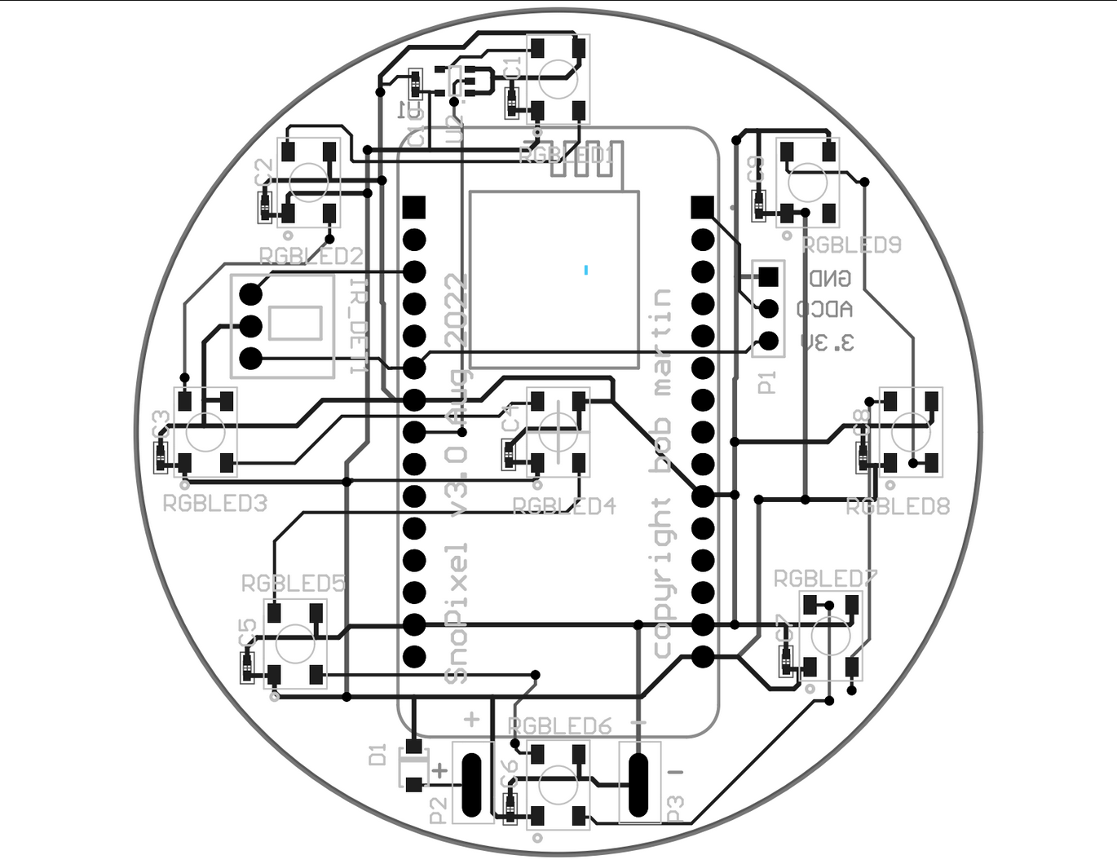
The Problem:A Display That Keeps Failing
Partner PCB Design
Node Dropouts
RF Congestion
No Weatherproofing
Individual ornaments lose connectivity unpredictably mid-display
Signal interference causes widespread disconnection across the whole network
Rain and cold temperatures degrade performance with no protection
Existing system: prone to dropouts and signal loss
Overall: Every failure means CORAL staff troubleshoot hardware instead of supporting students

Slide 4
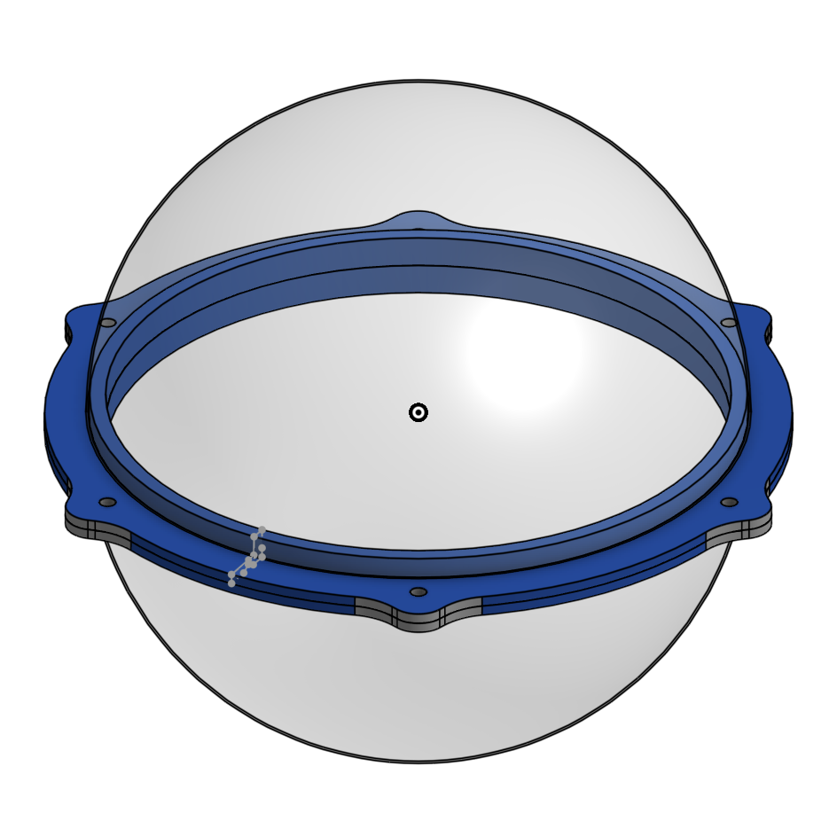
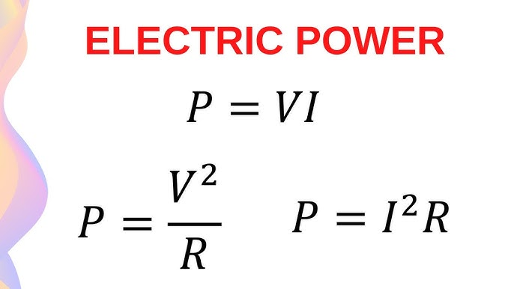
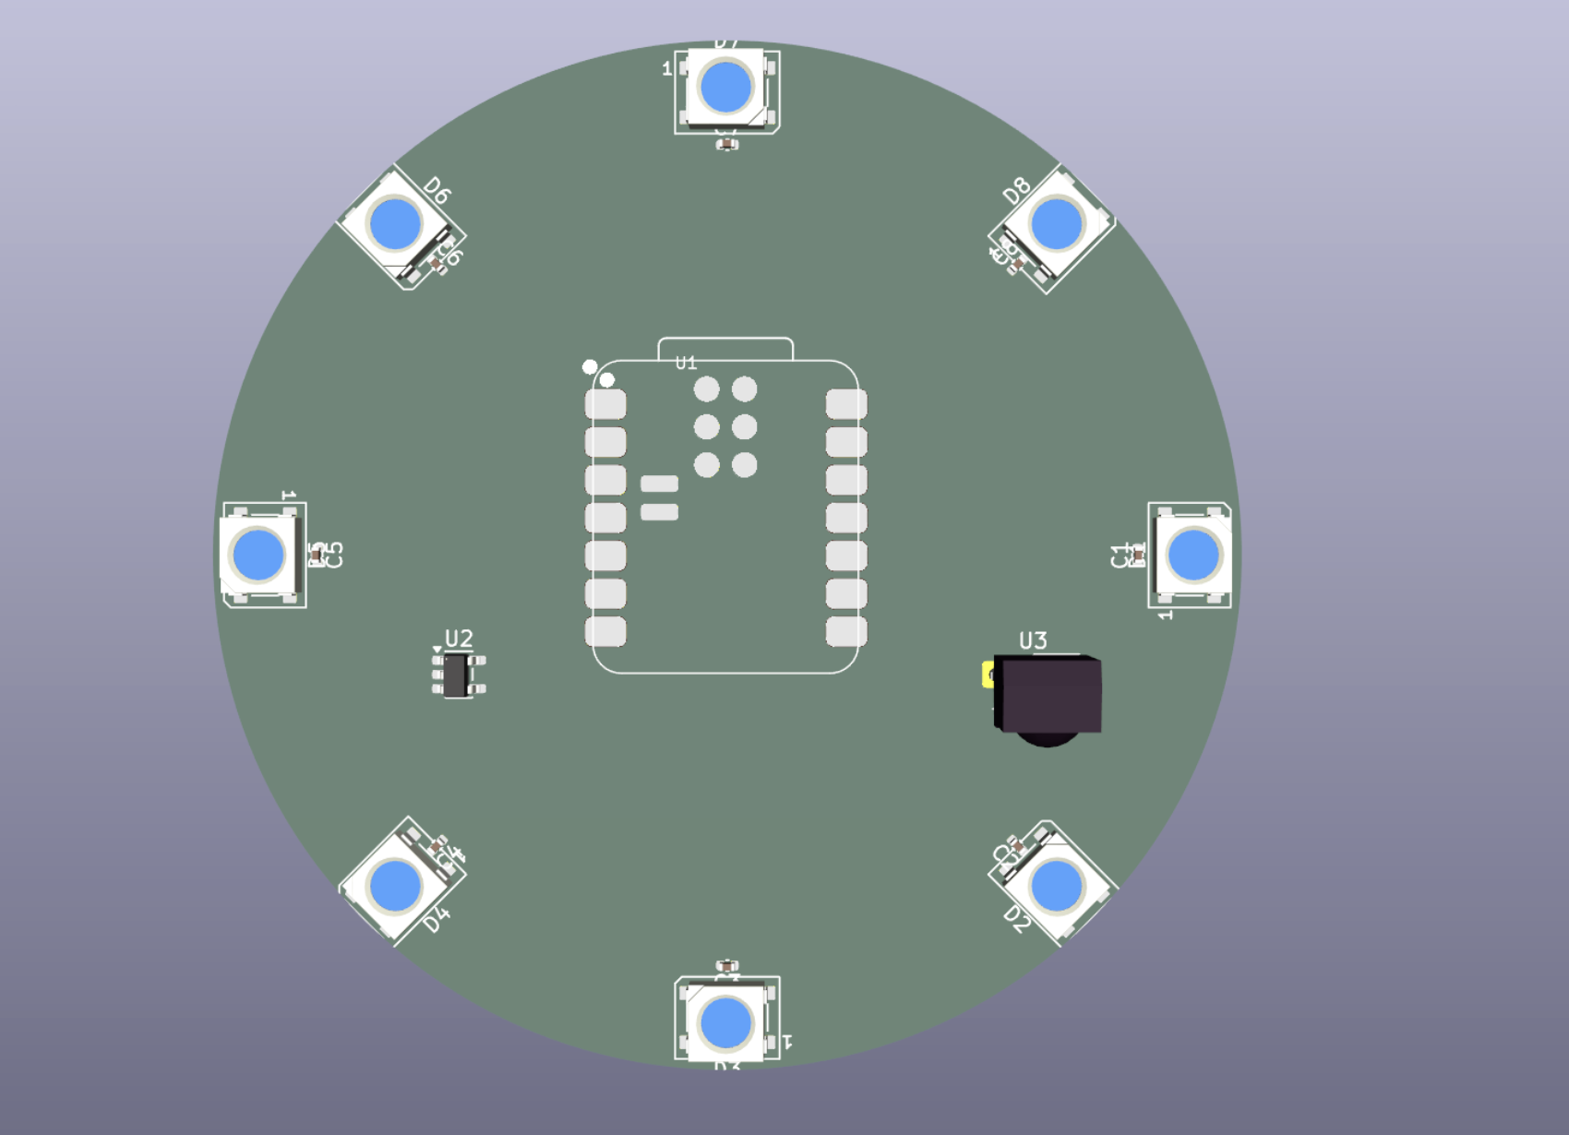
Our Solution- Our Design and Scope
Power Scoping
5V system, up to 480mA max per ornament (8 WS2812B LEDs × 60mA),
P = 5V × 0.48A = 2.4 Watts per ornament (peak)
Enclosure Design
PCB Design
Circular form factor designed to fit the existing CORAL ornament housing and protect electronics outdoors. Used existing injection mold to and O ring to make it work.
Designed a custom board in KiCad 10.0 integrating the Seeed XIAO ESP32, LED driver circuitry, and weatherproofing considerations
3D model of the PCB in progress
CAD render of enclosure design

Slide 5
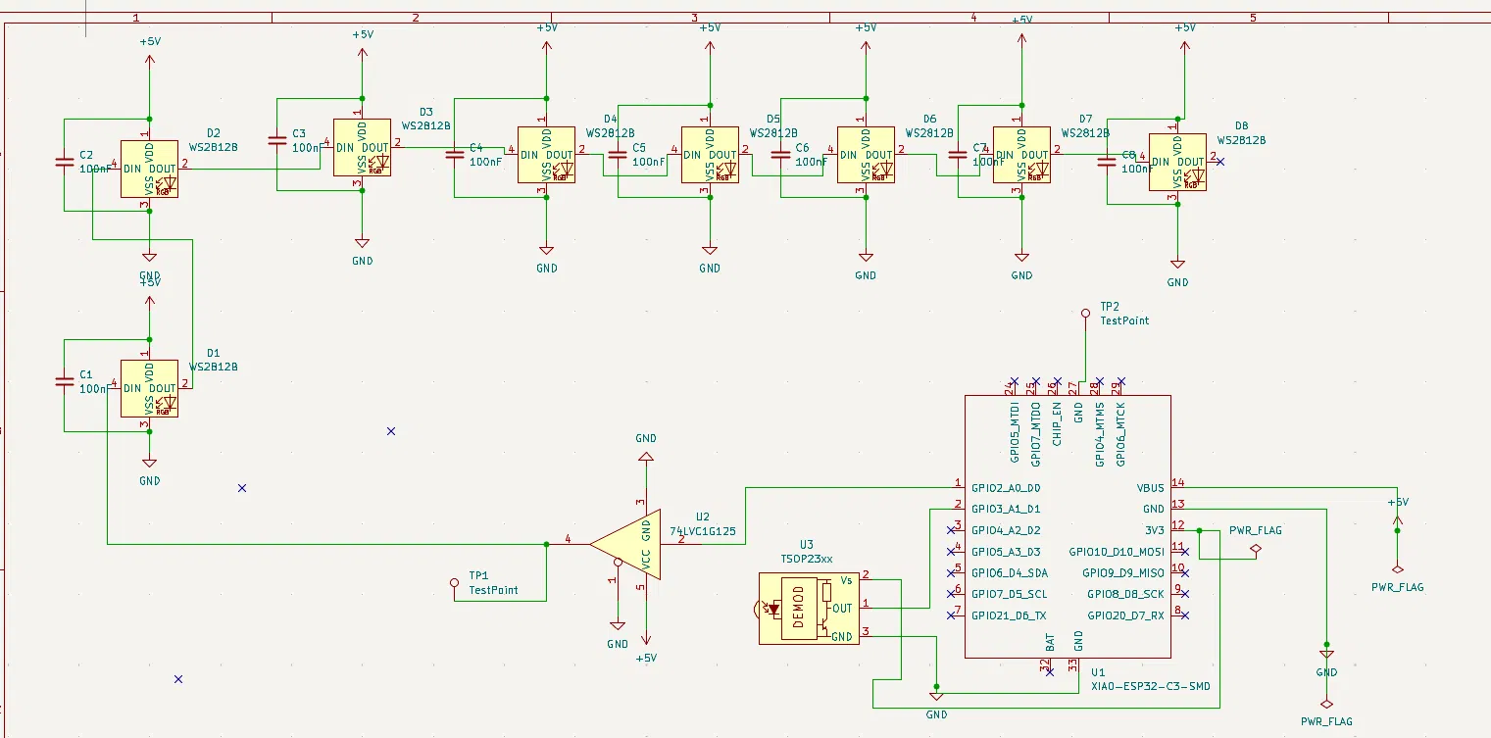
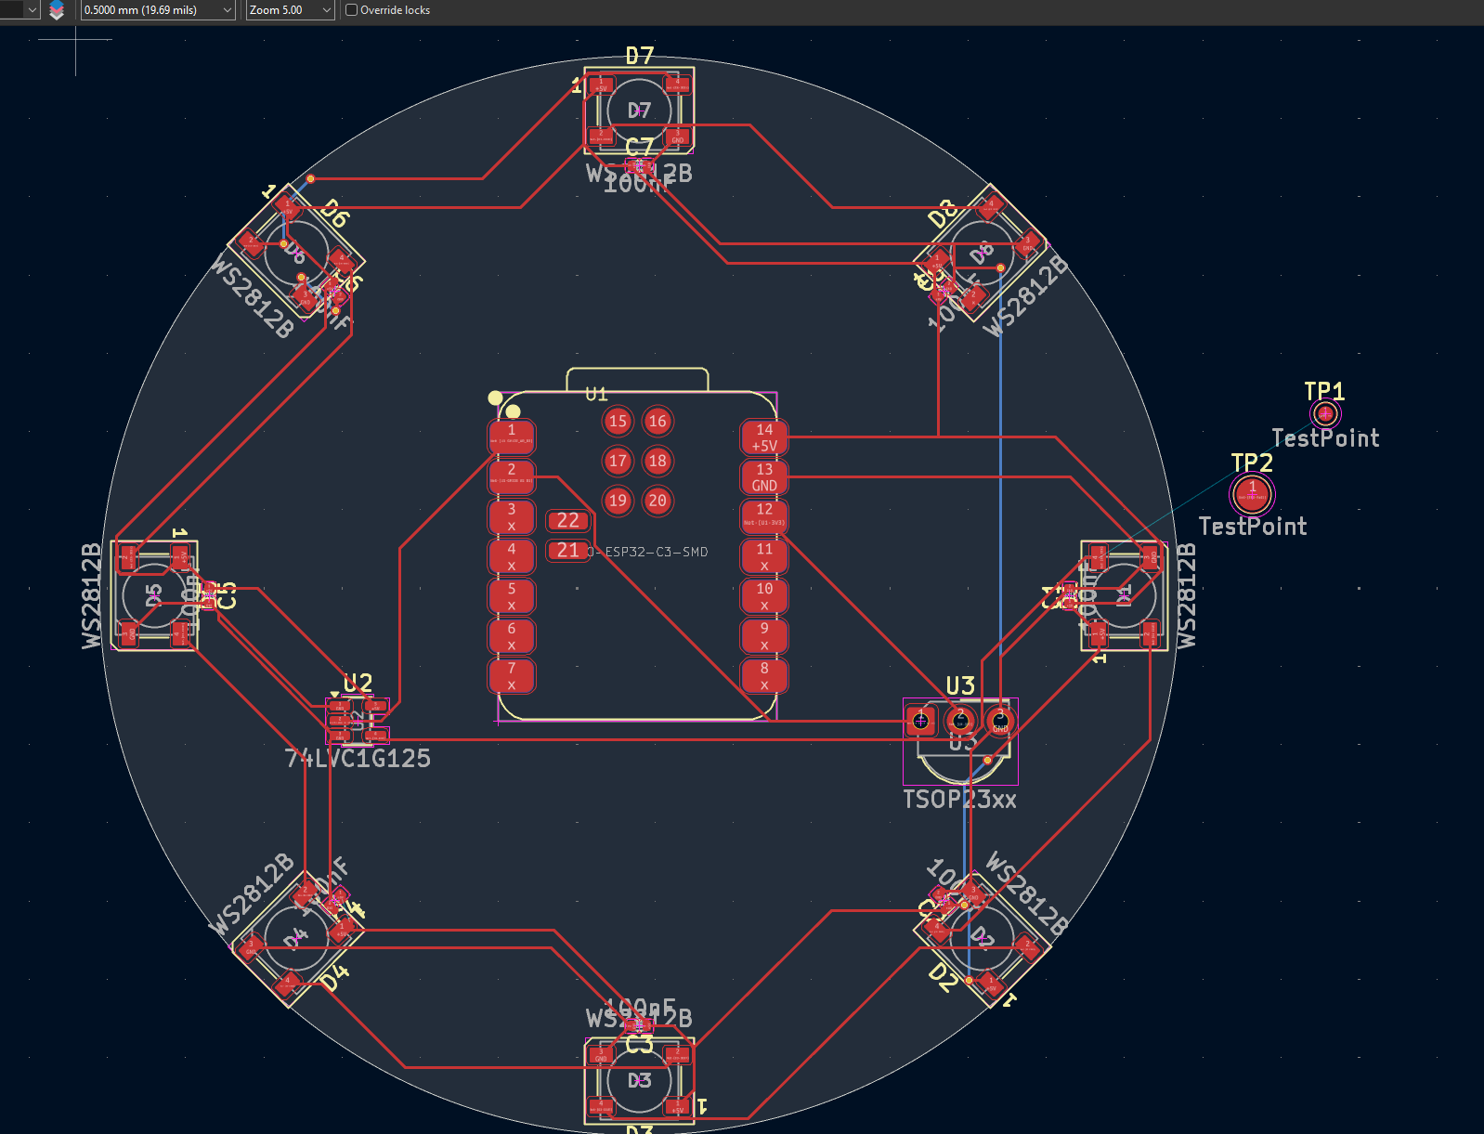
Schematic and PCB
Schematic of the Christmas ornament
Copied the old blueprint but replaced a new microcontroller (ESP-32C3)
PCB Design and routing the components together

Slide 6
Enclosure Design
The Problem + Deliverable Requirements
Internal Access
Aesthetic & elegant
Watertight
Firmware Updates
Maintenance
Futureproofing (Future Iteration in Same Footprint)
Legacy Hardware Used modified Commercially available enclosure
Dremeled Hole - Epoxy seal
Design should survive an entire holiday season deployed in the park
Initial Prototyping Decisions
Closure
Threaded hemispheres (equator split)
Secure
No added failure points (fewer moving parts)
Wire Entry
Grommet Hole at peak of top hemisphere
Allows discreet wiring directly up to hook
Sealed with epoxy
Material
Translucent PETG
Way better than transparent PLA
.2mm layer height for diffusion quality
0-10% infill
Sand after to improve diffusion

Slide 7
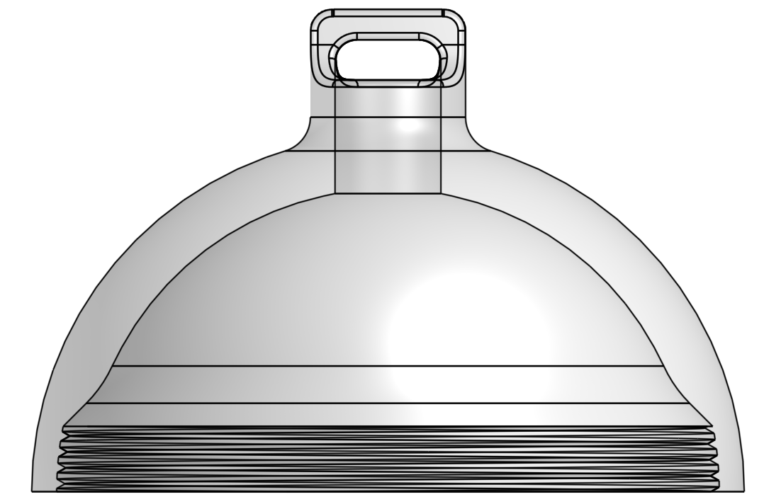
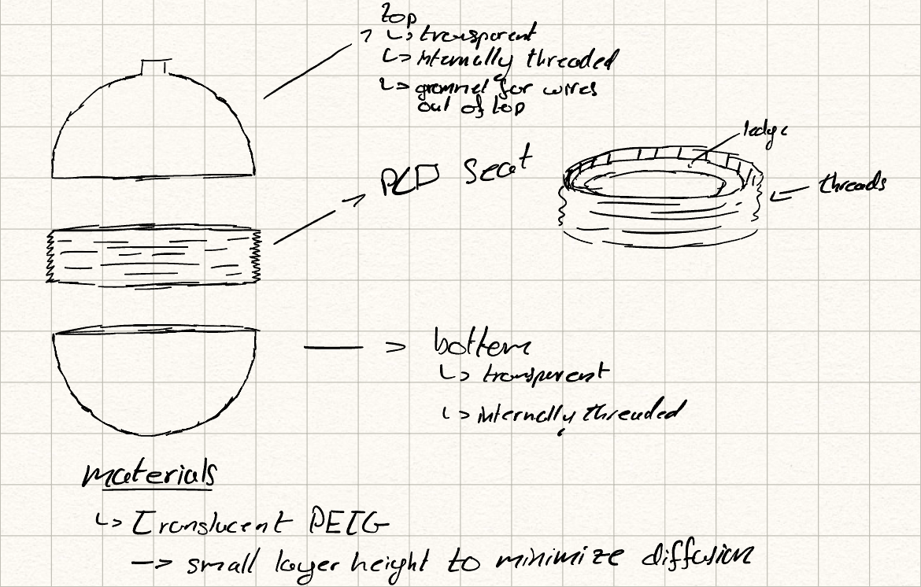
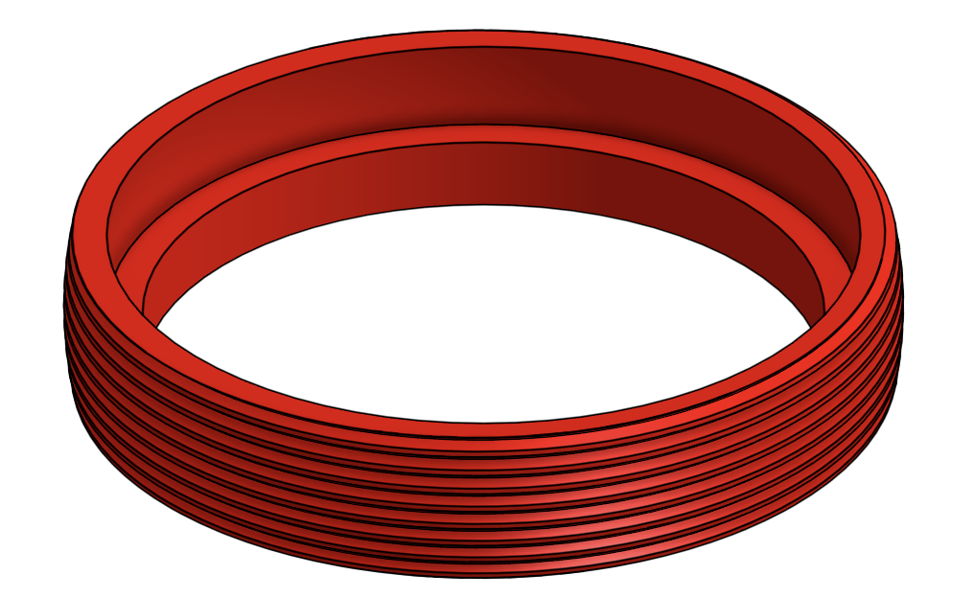
Enclosure Design
Initial Prototype

Slide 8
Enclosure Design
Feedback and Second Prototype
Printing Complexity
Minimize Parts
Prototype has 3 unique pieces per unit - material heavy
Single printed part, 2 per enclosure
Diffusivity
Hybrid Material
Diffusivity counterintuitive to emphasis on visual display - even with extensive post processing of print.
Injection Molded original enclosure for transparency, Printed part for seal & seat - secured with epoxy
Weather Seal
O-ring Closure
Threaded seal will not be watertight - capillary action will pull water along gaps - teflon tape is an added layer of complexity.
6 m2 screws compress an o-ring between the two hemispheres.

Slide 9
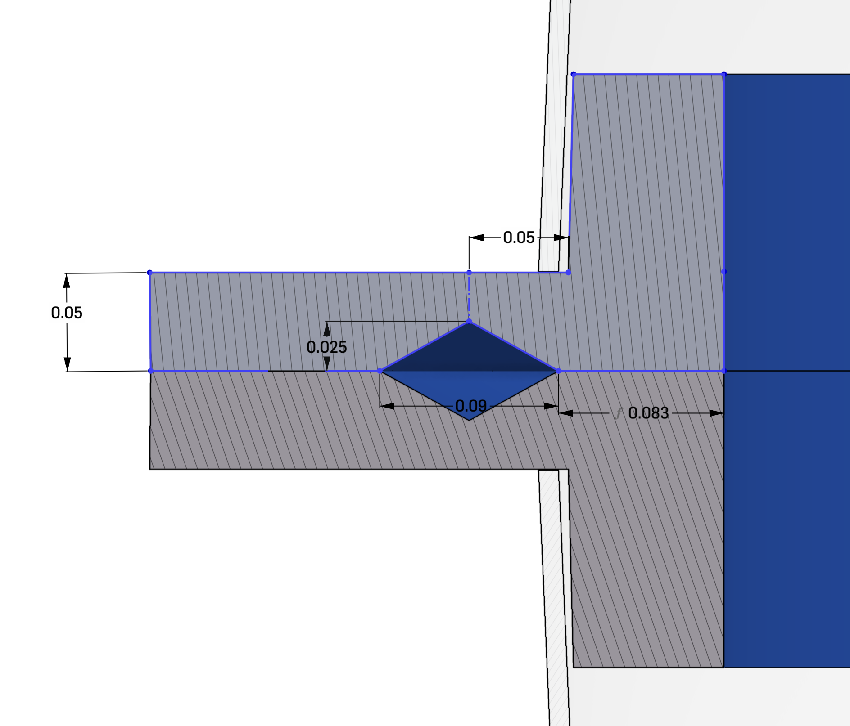
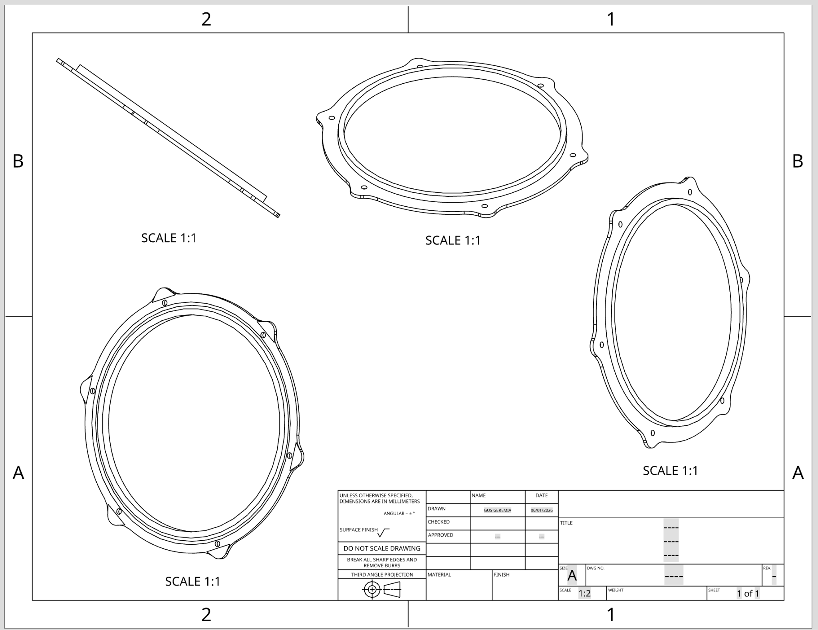
Enclosure Design
Finalized Design Based on Feedback
Printed Part w/ molded part
Square Groove + epoxy seal
Enclosure Drawing
Final drawing of single printed part - 2 per enclosure.
6 M2 bore holes for bolt + nut to compress o-ring. Injection Molded Commercially available part pictured
Groove manufactured for 1/16th inch o-ring. Achieves ~ 30% compression with .05mm vertical clearance.

Slide 10
What We Accomplished
Lessons Learned
Dove into design before fully scoping, cost time on network architecture
Network topology (ESP-NOW node count, range, mesh structure) remains an open item
Earlier stakeholder alignment would've sharpened our requirements faster
WINS
Met all core CORAL requirements
Scoping the PCB and enclosure
Prototyped enclosure w/ project specific needs and resource minimization
Note: All open items are documented in the handoff report for the next team to build on.

Slide 11
NEXT
STEPS
1
HAND OFF DESIGN FILES
KiCad schematic, PCB layout, CAD enclosure, and project scope ready for the next team
2
SOLDER & ASSEMBLE
Next team solders the PCB, assembles the enclosure, and begins physical prototyping
3
DESIGN NETWORK ARCHITECTURE
Define ESP-NOW topology, node count, range, hub vs mesh structure, and controller logic
4
BUILD & FIELD TEST
Assemble the physical board, validate enclosure tolerances, and test at a Christmas in the Park environment

Slide 12


THANK
YOU!
John & Catholic Charities CORAL — For your partnership, guidance, and mission-driven work supporting students in our community
Professor Zand — For your instruction and support throughout the ENGR 110 course
Nicholas — For your guidance and feedback as our TA
Santa Clara University & ENGR 110 — For providing the opportunity to work on real-world community engineering

